Slide 1
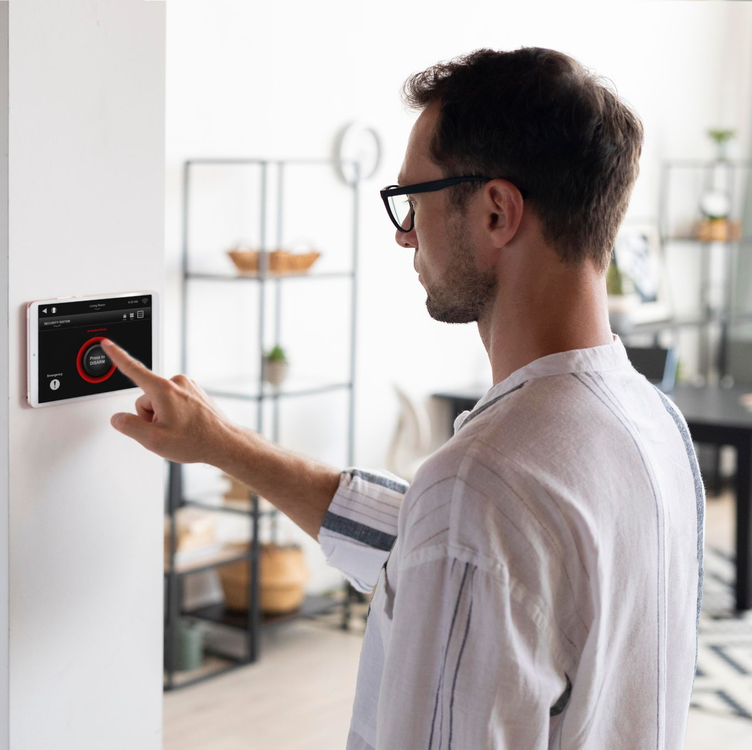
SMART HOME PROJECT
Using ATMEGA32

Slide 2
TABLE OF CONTENTS
01
04
About the project
Layered Architecture
02
05
Project Goals
Project Output
03
06
Activity Diagram
Our Team

Slide 3
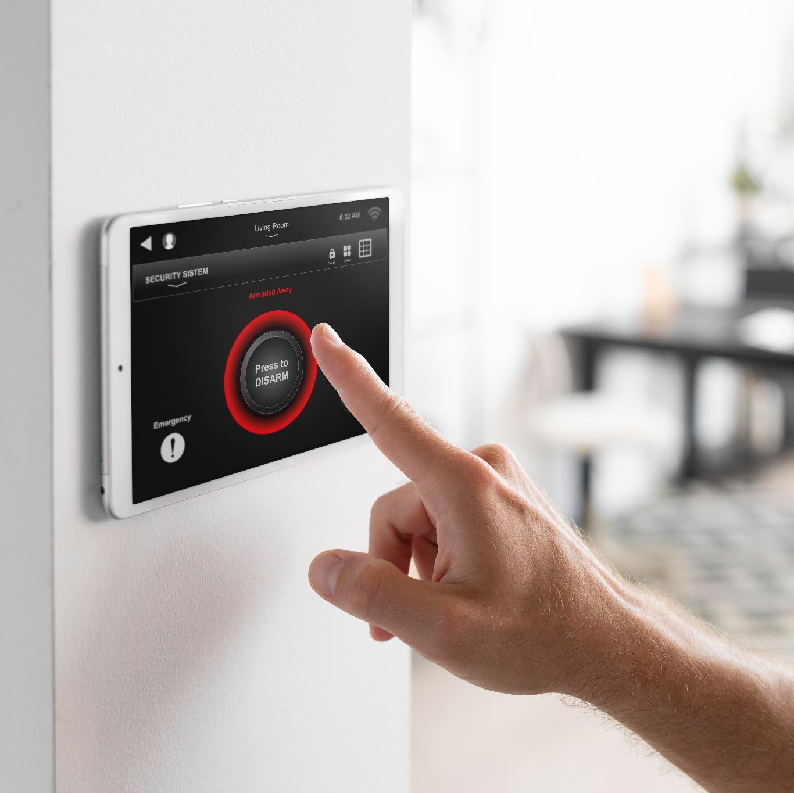
01.
About the project

Slide 4
WHAT WE ARE WORKING ON?
.
A smart home project utilizing ATmega32 microcontroller involves creating an intelligent system that efficiently manages various household functionalities like room control, air conditioning, television, temperature monitoring, and door access.
.
Two modes are available to access the system: admin mode and user mode. These modes differ primarily in terms of access levels, permissions, and functionalities.

Slide 5
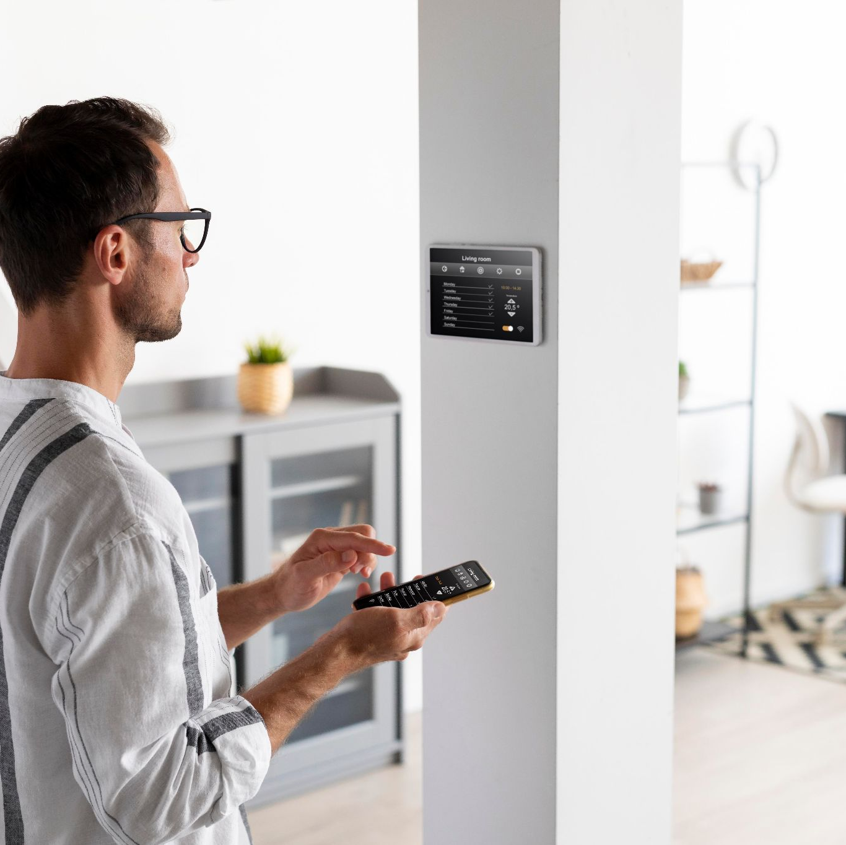
02.
Project Goals

Slide 6
PROJECT GOALS
The project aims to convert any thing around to be controllable and smart.
Ensure ease of system maintenance and updates over time.
Implement clean and well-structured code, use comments and documentation.
Develop a flexible architecture that allows for easy addition of new features.
Ensure that the codebase is easily understandable and navigable by developers.

Slide 7
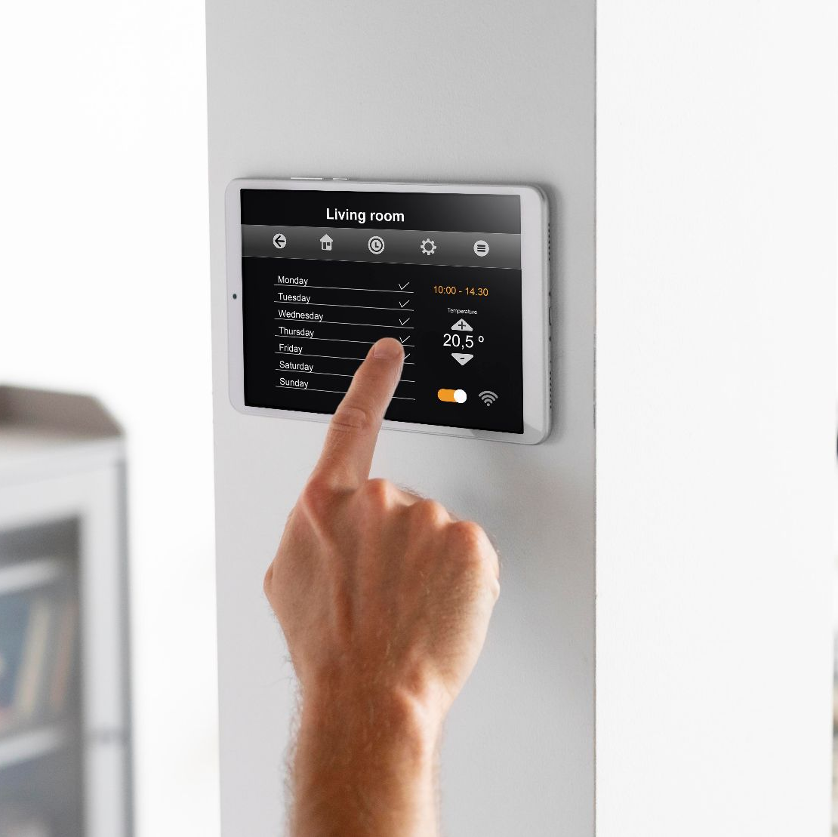
03.
Activity Diagram

Slide 8
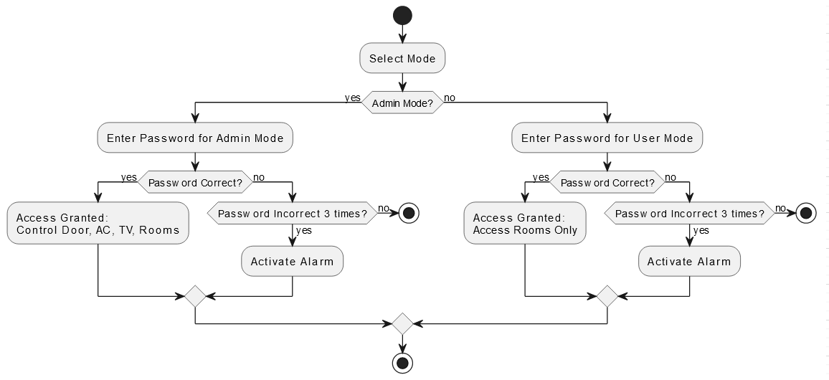
Activity Diagram

Slide 9
04.
Layered Architecture

Slide 10
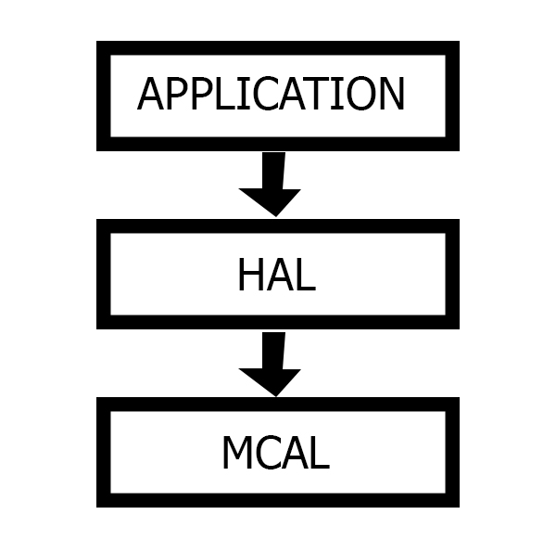


Master Code
Main
keypad, LCD, LED
DIO, SPI, Timer, EEPROM

Slide 11
Slave Code
Main
LED
ADC, SPI, Timer, DIO

Slide 12
05.
Project
Output

Slide 13
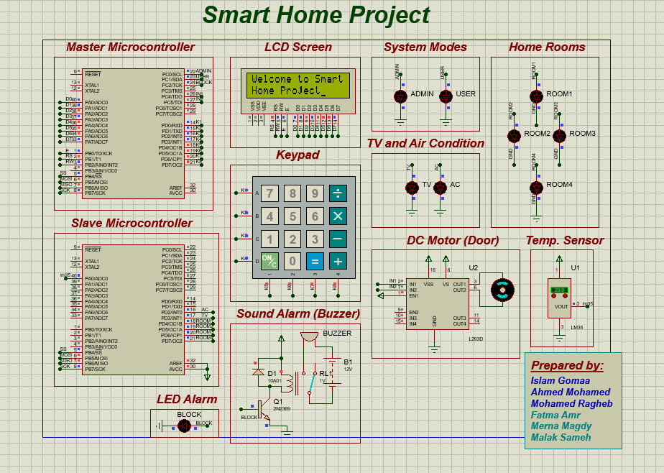
Proteus Simulation

Slide 14
OUR TEAM
Islam Gomaa Abouelfetouh islam.6800@yahoo.com
Ahmed Mohamed Abdelsalam ahmeddawoud3131@gmail.com
Mohamed Ragheb Mohamed Mohamed2002mohame@gmail.com
Fatma Amr Hassan
Famr00250@gmail.com
Merna Magdy Gamil
merna.magdy6@msa.edu.eg
Malak Sameh Ali
malak.sameh@msa.edu.eg

Slide 15
THANKS
Do you have any questions?

